Slide 1

Project Title - Seasonal Agriculture Performance Analysis
Student Name: Chidibomma Anand Santhosh College Name: International Institute of Business Studies
AICTE STU ID: STU6a5f97fb47ad41784649723

Slide 2

PROBLEM STATEMENT
Agricultural activities are influenced by seasonal variations in environmental conditions, farming practices, resource availability and market conditions. As a result, agricultural performance may differ from one season to another. However, raw agricultural data does not clearly explain how agricultural performance changes across seasons or what patterns can be observed in different seasonal conditions. The problem is to analyze the given agricultural dataset and investigate seasonal differences in agricultural performance by identifying meaningful patterns, trends, relationships and variations within the available data.

Slide 3
PROJECT DESCRIPTION
• Analyze 4,000 farm records covering 8 states, 8 crops, 3 seasons and 4 irrigation methods.
• Study yield, production, market price, cost, revenue, profit, water use and disease/pest risk.
• Compare performance across crops, seasons, states and irrigation methods using visualizations.
• Identify useful patterns and relationships to support data-driven agricultural planning.
• Dataset has 28 variables; 120 missing values are present across rainfall, soil moisture and yield.

Slide 4

WHO ARE THE END USERS?
• Farmers – compare crop and irrigation performance and understand profitability.
• Agricultural officers – monitor regional and seasonal performance.
• Agri-businesses – evaluate production, costs, market prices and profits.
• Researchers / students – explore agricultural trends and relationships.
• Policy planners – use summarized evidence for resource and water-management decisions.

Slide 5

TECHNOLOGY USED
• Python – data analysis and visualization.
• Pandas – data loading, cleaning, grouping and statistical analysis.
• Matplotlib – charts and visual presentation of results.
• CSV dataset – structured source containing 4,000 farm records and 28 variables.
• Microsoft PowerPoint – presentation of project findings.

Slide 6
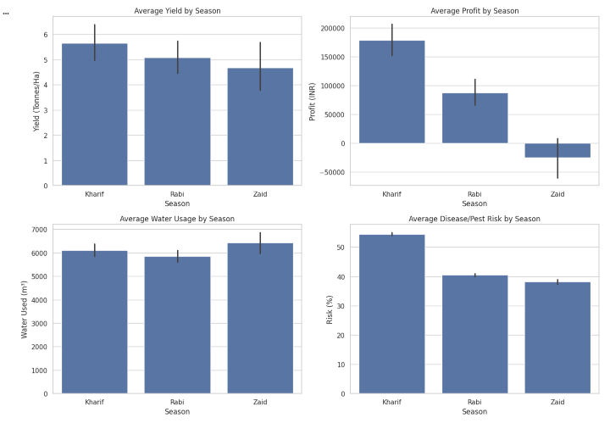
RESULTS

Slide 7
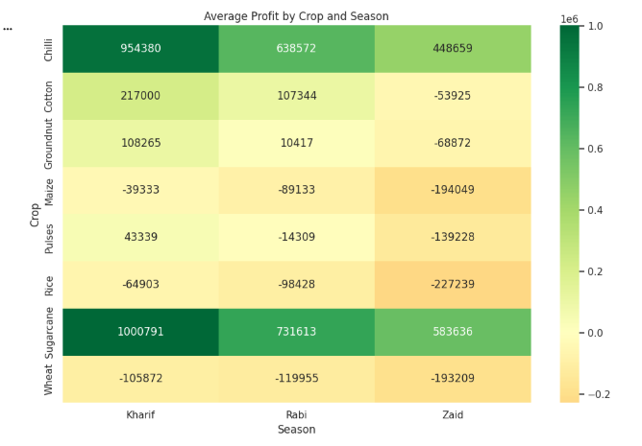
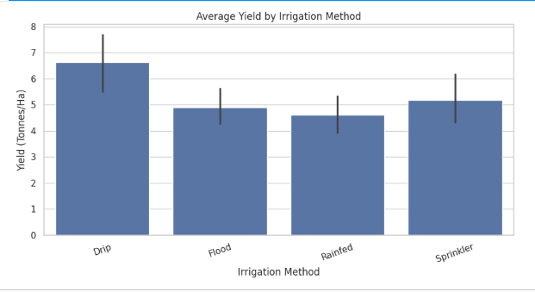
RESULTS

Slide 8
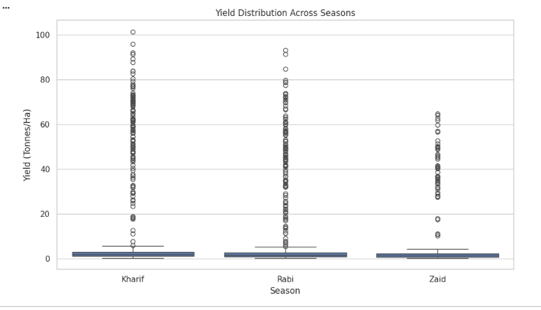
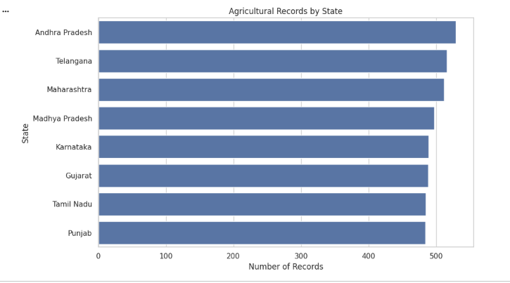
RESULTS

Slide 9
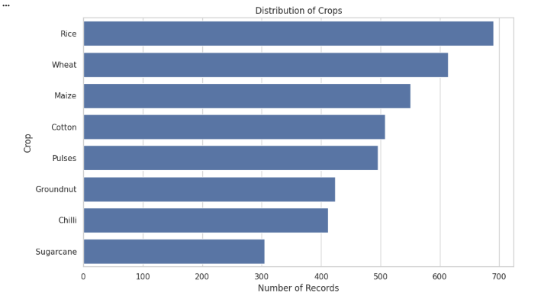
RESULTS

Slide 10
Future Scope
• Build an interactive dashboard in Power BI or Tableau for filtering by state, crop and season.
• Apply predictive models to forecast yield and farm profit.
• Add weather forecasts and real-time soil/moisture sensor data.
• Develop crop and irrigation recommendations based on historical performance.
• Use geospatial maps to identify high- and low-performing agricultural regions.
• Improve data quality through systematic missing-value treatment and outlier detection.

Slide 11
• GitHub repository: [link]
https://github.com/Anand9989/seasonal-agriculture-performance-analysis.git

Slide 12
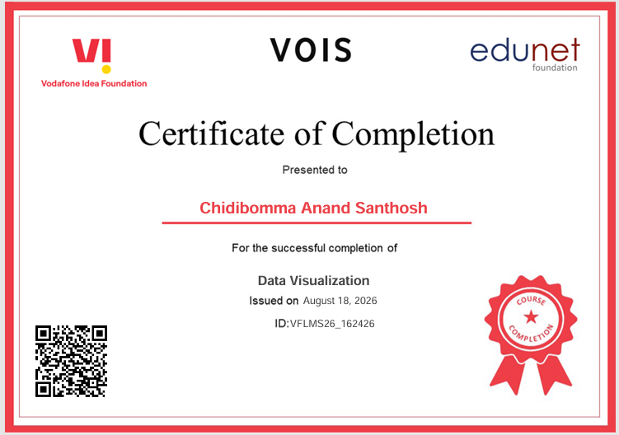
VOIS Data Visualization course completion certificate

Slide 13
THANK YOU

